Slide 1


DEVELOPMENT OF INTEGRATED WEARABLE DEVICE FOR REMOTE MONITORING OF PREGNANT WOMEN IN GHANA
Project Supervisor
Dr. Godfrey Mills
Co-Supervisor
Prof. Elsie Effah Kaufmann
Group Members
Owoh Einsteina Ofunne - 10943874
Anane George Nyarko – 10947340
Adika Nathaniel - 10957036
DATE: 6th December,2024
UNIVERSITY OF GHANA

Slide 2

COLLABORATORS
Nathaniel

Slide 3
TASKS FOR THE WEEK
INTRODUCTION
PROBLEM TO BE SOLVED
OBJECTIVES
EXISTING SOLUTIONS DONE AROUND THE PROBLEM
PROPOSED SOLUTION
METHODOLOGY

Slide 4
INTRODUCTION
Pregnant women are monitored to detect and prevent maternal or fetal complications.
Monitoring of pregnant women is a critical thing that needs to be carefully handled, otherwise it will lead to loss of mother or baby.
They are typically monitored for vital signs like; body temperature, blood pressure, heart rate, blood glucose levels, and oxygen saturation which help in assessing the health of both mother and baby.

Slide 5
INTRODUCTION
Body Temperature: Detects fever or infections that could harm both mother and fetus.
Blood Pressure: Monitors for hypertension disorders like preeclampsia to prevent complications.
Oxygen Saturation: Tracks oxygen levels to prevent anemia and maternal respiratory issues.
Heart Rate: Assesses cardiovascular health to ensure the heart is coping with pregnancy demands.
Blood Glucose Level: Identifies gestational diabetes to manage risks for mother and baby.

Slide 6
INTRODUCTION
Neglecting monitoring can lead to cases such as; preeclampsia, anemia, low birth weight and developmental delays and ultimately lead to death.
Traditionally, pregnant women are monitored through regular antenatal visits with modern methods now incorporating remote technologies like wearable devices for convenience and enhanced data accuracy.

Slide 7
PROBLEM DEFINITION
In Ghana, 12% of female deaths (ages 15-49) in the previous 5 years stem from pregnancy complications, with 62% due to late or poor medical intervention.
Unavailability of a real-time monitoring system for pregnant women increases maternal health risks.
Late detection of pregnancy complications such as preeclampsia and anemia lowers chances of survival of pregnant women.

Slide 8
OBJECTIVES
To develop a wearable-device to continuously track health status of pregnant women.
To develop a mobile-app for data-analytics of monitored physiological biomarkers.
To train an AI model for early detection and risk prediction of pregnancy complications like preeclampsia and anemia long before standard detection window.

Slide 9
EXISTING WORKS
TITLE : A Comprehensive Framework for Wearable Module for Prenatal Health Monitoring and Risk Detection(2024) ^{[1]}
GOAL : A system to continuously monitor health of pregnant women throughout pregnancy and send SMS to healthcare providers in event of any anomaly in vitals measured or a fall.

Slide 10
EXISTING WORKS
METHODOLOGY :
Temperature, Heart rate, Oxygen Saturation, Blood pressure, Blood Glucose are the vitals monitored.
Fall detection of pregnant woman and fetal kick monitoring is implemented in this system.
DS18b20 sensor is used for temperature readings and MAX30100 sensor monitors oxygen saturation and heart rate.
Off the shelf blood pressure device is equipped with EEPROM

Slide 11
EXISTING WORKS
NIR 940mm led and a photodetector to detect the blood glucose level.
Acceleration parameters of MPU6050 is used to detect falls of pregnant woman.
Acceleration parameters of ADXL335 is used to detect fetal movement.
A noticeable increase in acceleration values of above sensors indicate fetal movement.
System transmits user data after each 30- second interval .

Slide 12
EXISTING WORKS
ESP-32s microcontroller collects data and sends it over the Cloud using WIFI.
Mobile and Web App stores data in a database and is used by doctor to analyze historical data.
Heart rate sensor, Oxygen Saturation sensor and Blood Glucose sensor are placed on the fingers with temperature sensor on the underarm of a patient.
Blood Pressure device is worn on the wrist and the sensors for fall detection and fetal movement around the patient's waist.
All the above sensors are connected to the main processing unit.

Slide 13
EXISTING WORKS
RESULTS :
The system underwent evaluation by 4 volunteers.
Commercially available thermometer, pulse oximeter, blood pressure machine, blood glucose monitoring device were used as reference devices.

Slide 14
EXISTING WORKS
RESULTS :
Temperature Measurement : Mean Squared Error(MSE) of only 0.0035
Oxygen Saturation and Heart Rate :MSE of 1.1 and 2.45 respectively.
Blood Pressure: Mean Average Percentage Error(MAPE) of 4.54% for systolic blood pressure and diastolic blood pressure is 5.43%.
Glucose Blood Level : MAPE of 4.77%
Fall detection and fetal movement is monitored via abrupt changes in sensor values.

Slide 15
EXISTING WORKS
STRENGTHS: The values obtained from the wearable device compared to commercial devices goes to show the high level of accuracy of the system.
GAP : No mechanism for predictive analysis of patient's vitals to forewarn a risk of complication or possible illness of mother.

Slide 16
EXISTING WORKS
TITLE : Wearable Technology Model to Control and Monitor Hypertension during Pregnancy(2024) ^{[3]}
GOAL: A system to control and monitor Preeclampsia where a wearable captures blood pressure, heart rate and patient steps and an alert is sent to both health care providers and patient in event of high blood pressure.

Slide 17
EXISTING WORKS
METHODOLOGY :
A “V07” wearable device which is compatible with Android and IOS is used.
SAP cloud platform (SAP HANA) is used.
Mobile application collects data from cloud which is available to doctor and expectant mother
Monitored vitals included blood pressure, heart rate and patient steps

Slide 18
EXISTING WORKS
METHODOLOGY :
The wearable device is connected to a smartphone via Bluetooth to transfer data to the mobile application.
All data captured by the wearable is passed immediately to the cell phone and the memory of the wearable will be cleaned to obtain new data.
This case occurs when the cell phone is not connected to the wearable, otherwise the data will be stored directly in the cell phone memory.
Data is uploaded to the cloud every 30 minutes.

Slide 19
EXISTING WORKS
METHODOLOGY :
The patient is able to monitor his health anytime through the statistics shown in the application and also visualize the medicines that one must take, appointments and patient's treatment.
An alert is sent to the health organization and the patient when an incident of high blood pressure is present, this alert also shows the location on google maps in which the patient is located.
Weight, age and gestational age must be entered by the user manually in the application

Slide 20
EXISTING WORKS
METHODOLOGY :
The stored data automatically transferred to the SAP HANNA database from the mobile device and the data will be deleted from the phone memory.

Slide 21
EXISTING WORKS
RESULTS :
The Social Health Insurance Hospital also called EsSalud was the healthcare organization where the model was validated.
Prior to the implementation of the model, there were no records of controlling and monitoring cases of hypertension among pregnant women.
The system was tested with 20 pregnant patients who live in Lima and their gestational were between 3 months and 9 months as study was conducted between October and December 2017.

Slide 22
EXISTING WORKS
RESULTS :
The Social Health Insurance Hospital also called EsSalud was the healthcare organization where the model was validated.
Prior to the implementation of the model, there were no records of controlling and monitoring cases of hypertension among pregnant women.
The system was tested with 20 pregnant patients who live in Lima and their gestational were between 3 months and 9 months as study was conducted between October and December 2017.

Slide 23
EXISTING WORKS
RESULTS :
Out of the total subject pool, we found that 70% of the subjects (14 pregnant women) had abnormal health parameters during the study.
In their thirtieth month, pregnant patients had a greater number of alerts for high blood pressure and high heart rate compared during their twentieth month of gestation.
The system helped healthcare providers develop preventive and corrective actions starting from week 28th of pregnancy.

Slide 24
EXISTING WORKS
RESULTS :
The number of controlled patients was increased by 11% and the rate of maternal deaths was reduced by 7%
The pregnant patients expressed satisfaction with the model because they felt empowered by checking and monitoring their own health.
The doctors could treat their patients on time based on the values of their blood pressure and heart rate and start developing strategies to improve the care of pregnant women

Slide 25
EXISTING WORKS
RESULTS :
Graphs in the mobile app showed all patients who had their blood pressure and heart rate controlled, analysis of the patients based on the healthcare parameters and the month of gestation where higher alerts by pressure or high heart rate occurred.
Information from the system helped the healthcare providers to start developing new strategies to control and monitor these patients more efficiently and effectively

Slide 26
EXISTING WORKS
STRENGTHS: There is analysis of data collected to help deploy new strategies to monitor and treat patients effectively.
GAP : Data Security measures are not implemented.

Slide 27
EXISTING WORKS
TITLE :Health Monitoring Of Expecting Mothers Using Multiple Sensor Approach: "Preg Care" (2020) ^{[6]}
GOAL : A system comprising numerous sensors to provide complete health monitoring during the pregnancy period.

Slide 28
EXISTING WORKS
METHODOLOGY :
The device monitors heart rate, body temperature, glucose rate, amount of oxygen in blood, anemic status and detects sudden fall of a pregnant woman.
WIFI and GSM Module is used for data transmission to cloud and a mobile app.
A mobile app is developed to allow pregnant women assess their health conditions and enable doctors take decisions based on recorded values.

Slide 29
EXISTING WORKS
METHODOLOGY :
All sensor data is sent to a microcontroller for processing and transmitted to a GSM module and a mobile app which sends data to ThingSpeak cloud server.
The doctor and relatives of the pregnant woman can access data by means of SMS and the app.
The device can be worn on the abdomen or the hand.

Slide 30
EXISTING WORKS
METHODOLOGY :
Max30100 sensor is used to monitor amount of oxygen in blood and pulse rate (indication of heart rate) concurrently.
Mlx90614 sensor is used to measure body temperature of the pregnant woman.
Heltec ESP32 OLED board is used to upload SPO2 and temperature value to the cloud server.
NIR LED-Photodetector system(940nm) is used to monitor the glucose rate.
GSM module uploads glucose rate data to the cloud server.

Slide 31
EXISTING WORKS
METHODOLOGY :
Arduino microcontroller is used to process all sensor data before uploads are made to the cloud.
A non-invasive glucose rate monitoring system is designed where the finger is placed on an IR sensor to measure glucose rate.
Notch filter is used in the circuit to reduce noise from the value obtained by the IR sensor.

Slide 32
EXISTING WORKS
METHODOLOGY :
ADXL-345(Accelerometer) is used for sudden fall detection.
The azimuth, roll and pitch are calculated, and the summing vector method is applied.
Wemos D1 Mini 1 is used to transmit fall detection data to the cloud and an emergency message is sent to a doctor or a relative of a pregnant woman.
A picture of the eye pallor of the expecting mother is processed by a machine learning algorithm to determine if a patient is anemic or otherwise.

Slide 33
EXISTING WORKS
METHODOLOGY :
Python-based image processing algorithm is used to detect anemia.
After pictures of eye pallor were taken, they were manually cropped and pre-processed to collect features.
109 images were used comprising anemic and non-anemic subjects.
81 images were used for the training dataset and 28 images were used for testing.
Permission was sought before this dataset was used.

Slide 34
EXISTING WORKS
METHODOLOGY :
Tree ,Random Forest, SVM, Logistic Regression, Naïve Bayes and KNN were the models used.
Orange data mining software is used for the machine learning classification.
The mobile app named "Preg-Care" is designed using Java.

Slide 35
EXISTING WORKS
RESULTS :
Tree has accuracy of 0.821 and area under curve of 0.824
Random Forest has accuracy of 0.750 and area under curve of 0.853
SVM has accuracy of 0.714 and area under curve of 0.840
Logistic Regression has accuracy of 0.714 and area under curve of 0.872
Naïve Bayes has accuracy of 0.679 and area under curve of 0.818

Slide 36
EXISTING WORKS
RESULTS :
KNN has accuracy of 0.643 and area under curve of 0.668
Decision Tree algorithm gave the highest efficiency hence it was selected for the classification.

Slide 37
EXISTING WORKS
STRENGTHS:
Application of image processing and machine learning to predict anemic status of patient.
Highly applicable to rural-settings

Slide 38
EXISTING WORKS
GAPS :
Manual Imputation of Blood Pressure value into the app.
ThingSpeak Server provides less data security.
Accuracy of components was not checked for as no gold standard measurement were done.
No predictive mechanism to forewarn of potential health issues of pregnant woman.

Slide 39
EXISTING WORKS
TITLE :Explainable Early Prediction of Gestational Diabetes Biomarkers by Combining Medical Background and Wearable Devices: A Pilot Study With a Cohort Group in South Africa(2024) ^{[5]}
GOAL : A system that forecasts biomarkers such as LDL, HDL, triglycerides, cholesterol, HbA1c(biomarker values)13 to 16 weeks prior to the Gestational Diabetes Mellitus(GDM) screening test.

Slide 40
EXISTING WORKS
METHODOLOGY :
The National Institute for Health and Care Excellence (NICE) guidelines recommend that all women with NICE risk factors of Body Mass Index >= 30,Previous GDM, Family History Of Diabetes and Previous Macrosomic Baby weighing 4.5kg or more should have an oral glucose test between 24-28 weeks to detect GDM.
This project helps to identify pregnant women at an increased risk of GDM based on Physical Activity (PA) recordings, medical backgrounds, including mental health records, and continuous

Slide 41
EXISTING WORKS
METHODOLOGY :
continuous glucose monitoring data collected from participant.
Participants between weeks 12 and 14 of pregnancy were monitored using Freestyle Libre glucose sensors and Empatica E4 wearable sensors to record physical activities such as sleeping, sitting and eating in a controlled environment for three minutes each.
Participants medical history and physiological measurements such as Body Mass Index (BMI) and blood biomarkers were collected.

Slide 42
EXISTING WORKS
METHODOLOGY :
Data was gathered between the 12th and 14th weeks and between the 24th and 26th weeks of pregnancy.
Only benchmark data acquired at the onset of the 12th week was used, as a significant portion of participants refrained from wearing the devices despite reminder calls.

Slide 43
EXISTING WORKS
METHODOLOGY :
Study’s participants were recruited from the antenatal clinic associated with the Chris Hani Baragwanath Teaching Hospital in Johannesburg, South Africa.
Eligible participant include those between 12–14 weeks pregnant, overweight or obese and capable of providing written consent.

Slide 44
EXISTING WORKS
METHODOLOGY :
The upper arm was used for recordings based on studies that demonstrated its superior accuracy compared to the back and chest.
The Freestyle Libre 2 stores 14 days’ continuous data in its in-device memory with participants receiving a second sensor for application after 14 days.
The devices were either collected by the research assistant or returned by the participant during a scheduled clinic visit.

Slide 45
EXISTING WORKS
METHODOLOGY :
At the end of the second and beginning of the third trimester (i.e. between week 25 and 28), an OGTT was conducted to identify individuals with GDM with the study receiving approval by the University of the Witwatersrand and University of Essex Ethics Committee.
The dataset includes information from background health information, CGM, and Empatica E4 data.

Slide 46
EXISTING WORKS
METHODOLOGY :
Health background data were collected using a survey consists of:
Eating Attitudes Test - Used to identify the presence of eating disorder risk based on attitudes, feelings and behaviors related to eating
Patient Health Questionnaire – For screening, diagnosing, monitoring and measuring the severity of depression

Slide 47
EXISTING WORKS
METHODOLOGY :
Pregnancy Physical Activity Questionnaire - For the assessment and measurement of physical activity levels amongst pregnant women
Global Physical Activity Questionnaire - For the surveillance of physical activity
RAND 36-Item Health Survey - A set of generic, coherent, and easily administered quality-of-life measures

Slide 48
EXISTING WORKS
METHODOLOGY :
Demographics and Historical Health Questions including questions about smoking, alcohol use, family history of diabetes, and previous pregnancy history or parity

Slide 49
EXISTING WORKS
METHODOLOGY :
Data was collected from 17 mothers at their enrolment visit.
Continuous Glucose readings were collected using the Freestyle Libre sensor which is placed on the upper arm and uses subcutaneous, wired enzyme glucose sensing technology to detect glucose levels in interstitial fluid.
Readings were taken every 15 minutes and stored on the sensor.

Slide 50
EXISTING WORKS
METHODOLOGY :
Data is stored on an external reader as it swipes at least every 8 hours.
Data from nine women was collected for 14 complete days, and only four of them continued to complete 28 days worth of continuous glucose data whereas the other eight mothers were not able to receive sensors due to COVID-19 lockdown restrictions

Slide 51
EXISTING WORKS
METHODOLOGY :
Infrared Thermopile collects peripheral skin temperature, and a 3-axis Accelerometer captures motion-based activity.
Sampling frequency for all sensors is 64 Hz.
Three minutes of recordings were collected in a controlled environment for each of the following activities: eating, sitting, walking, walking upstairs and downstairs, talking on the phone, and lying down.

Slide 52
EXISTING WORKS
METHODOLOGY :
Feature Extraction, Aggregation and Selection was performed on collected data.
Data Fusion With Coupled-Matrix and Tensor Factorisation-Alternating Least Squares is performed.
Regression Models of Decision Tree and Random Forest Regressor were used to estimate biomarker values collected between week 25 and 28 based on the data collected between weeks 12–14.

Slide 53
EXISTING WORKS
RESULTS FOR REGRESSION MODELS:
HbA1c Predictions:
Decision Tree(DT) : 0.34(∓0.06) MSE and 0.44 (∓0.04) MAE
Random Forest (RF): 0.36 (∓0.09) MSE and 0.43 (∓0.04) MAE.
OGTT Biomarker Predictions:
DT: 0.69 MSE and 0.01 MAE
1.46 (∓0.25) MSE and 0.78 (∓0.11) MAE

Slide 54
EXISTING WORKS
RESULTS FOR PREPROCESSING TECHNIQUES:
HbA1c Biomarkers:
CMTF-ALS : 1.19 (∓1.86) MSE, 0.68 (∓0.50) MAE.
Elastic Net: 1.47 (∓1.95) MSE, 0.80 (∓0.50) MAE
OGTT Biomarker Predictions:
CMTF-ALS: 0.36 (∓0.22) MSE, 0.43 (∓0.12) MAE.
Elastic Net: 0.38 (∓0.19) MSE, 0.46 (∓0.09) MAE.

Slide 55
EXISTING WORKS
RESULTS FOR BIOMARKER ANALYSIS:
Best Results(Using CG-E4-health data):
LDL : 0.29 MSE and 0.43 MAE
HDL : 0.32 MSE and 0.41 MAE
Other Biomarkers:
Triglycerides: 0.34 MSE and 0.43 MAE
Cholesterol: 0.33 MSE and 0.44 MAE.

Slide 56
EXISTING WORKS
RESULTS FOR BIOMARKER ANALYSIS:
HbA1c: 0.42 MSE and 0.45 MAE
Fasting Glucose: 2.44 (∓4.28) MSE and 0.91 (∓0.86) MAE
1-hour Post-Load Glucose: 0.95 MSE and 0.70 MAE
2-hour Post-Load Glucose: 1.08 MSE and 0.72 MAE

Slide 57
EXISTING WORKS
RESULTS :
None of our participants developed GDM.
Highly predictive models for OGTT values, as well as LDL, HDL, Triglycerides, Cholesterol, and HbA1c biomarkers was achieved.

Slide 58
EXISTING WORKS
STRENGTHS: This is the first GDM study attempting to forecast biomarker values associated with the presence of GDM 13 to 16 weeks prior to the GDM screening test.
GAP : No mechanism for analytics of captured data

Slide 59
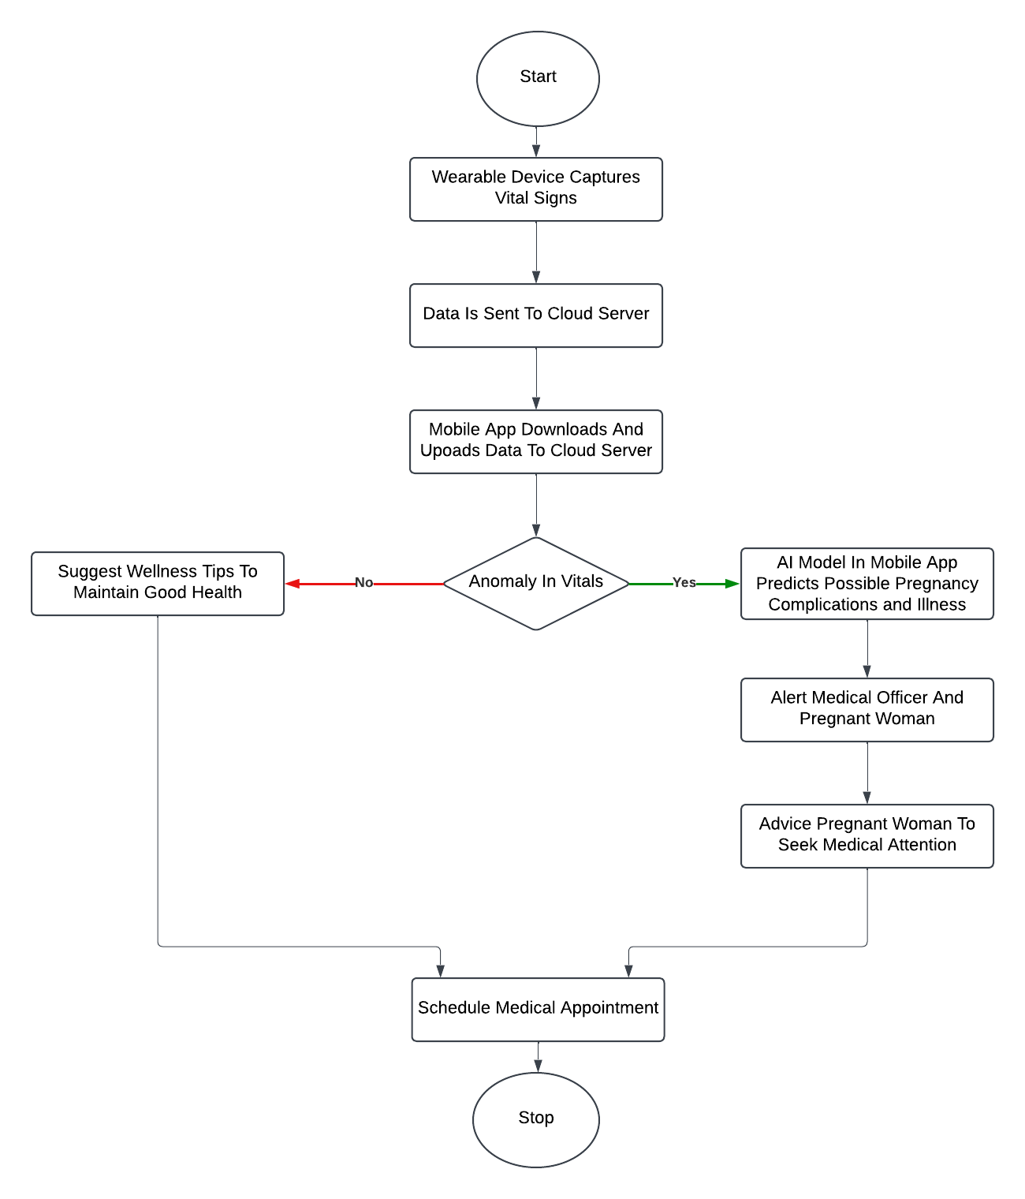
PROPOSED SOLUTION
FLOW DIAGRAM OF SYSTEM:

Slide 60
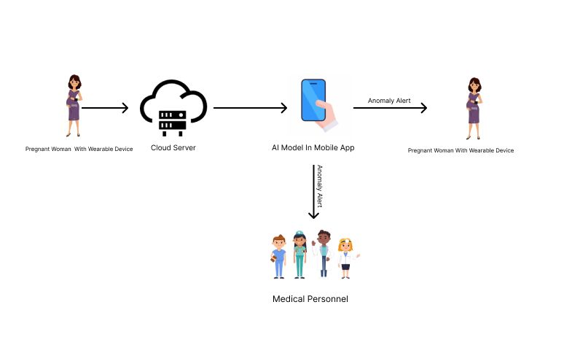
PROPOSED SOLUTION

Slide 61
PROPOSED SOLUTION
METHODOLOGY :
Physiological biomarkers are continuously monitored using a wearable device placed on the wrist of the pregnant woman.
The wearable device is administered from a hospital at onset of pregnancy such that the pregnant woman can be monitored even at home.
The vitals to be measured include:
Blood Glucose Level
Blood Pressure
Body Temperature

Slide 62
PROPOSED SOLUTION
METHODOLOGY :
Body Temperature
Blood Pressure
Heart Rate
Oxygen Saturation
The captured data is sent to a cloud server every 3 minutes.

Slide 63
PROPOSED SOLUTION
METHODOLOGY :
If anomaly is detected in recorded biomarkers, an AI model predicts possible pregnancy complications such as preeclampsia, anemia in pregnancy and gestational diabetes.
This prediction is done weeks ahead of the standard detection window.

Slide 64
PROPOSED SOLUTION
METHODOLOGY :
Data details are sent to the medical officer and the pregnant woman immediately.
A notification is sent to smartphone of pregnant woman to seek medical attention as soon as possible to initiate treatment.
Either the doctor or pregnant woman can schedule a medical appointment.

Slide 65
PROPOSED SOLUTION
METHODOLOGY :
If no anomalies in vitals are identified, wellness tips are sent to the pregnant woman to maintain her good health status.
The mobile app performs data analytics to identify trends and draw insights from captured physiological data.
The results of the data analytics are displayed to the pregnant woman and the medical officer.

Slide 66
REFERENCES
[1] T. Tabassum, S. Podder, and S. T. S. Rafid, "A Comprehensive Framework for Wearable Module for Prenatal Health Monitoring and Risk Detection," IEEE Int. Conf. Women Innov., Technol. Entrepreneurship (ICWITE), pp. 283-288, 2024.
[2] Y. K. Wiafe, A. Asamoah, P. Akweongo, and A. Kumah, "Factors Affecting Pregnancy Complications in Ghana," Global J. Quality Safety Healthcare, vol. 7, no. 4, pp. 156-161, 2024.

Slide 67
REFERENCES
[3] B. D. B. Lopez, J. A. A. Aguirre, D. A. R. Coronado, and P. A. Gonzalez, "Wearable technology model to control and monitor hypertension during pregnancy," Proc. IEEE, Lima, Peru, 2017.
[4] F. Sarhaddi, I. Azimi, S. Labbaf, H. Niela-Vilén, N. Dutt, A. Axelin, P. Liljeberg, and A. M. Rahmani, "Long-Term IoT-Based Maternal Monitoring: System Design and Evaluation," Sensors, vol. 21, no. 7, p. 2281,2021.

Slide 68
REFERENCES
[5]A. F. Hernández-Castañeda, R. Pardo-Gómez, M. Sierra-Sosa, and A. García-Ramos, "Explainable Early Prediction of Gestational Diabetes Biomarkers by Combining Medical Background and Wearable Devices: A Pilot Study With a Cohort Group," Sensors, vol. 22, no. 15, p. 5793, 2022
[6] A. Kumar, D. Sharma, and V. Gupta, "Health Monitoring of Expecting Mothers using Multiple Sensor Approach: 'Preg Care'," in Proceedings of the 2nd International Conference on Advanced Information and Communication Technology (ICAICT), 2020, pp. 77-82

Slide 69
MISCELLANEOUS
QUESTIONS/FEEDBACK

